Slide 1

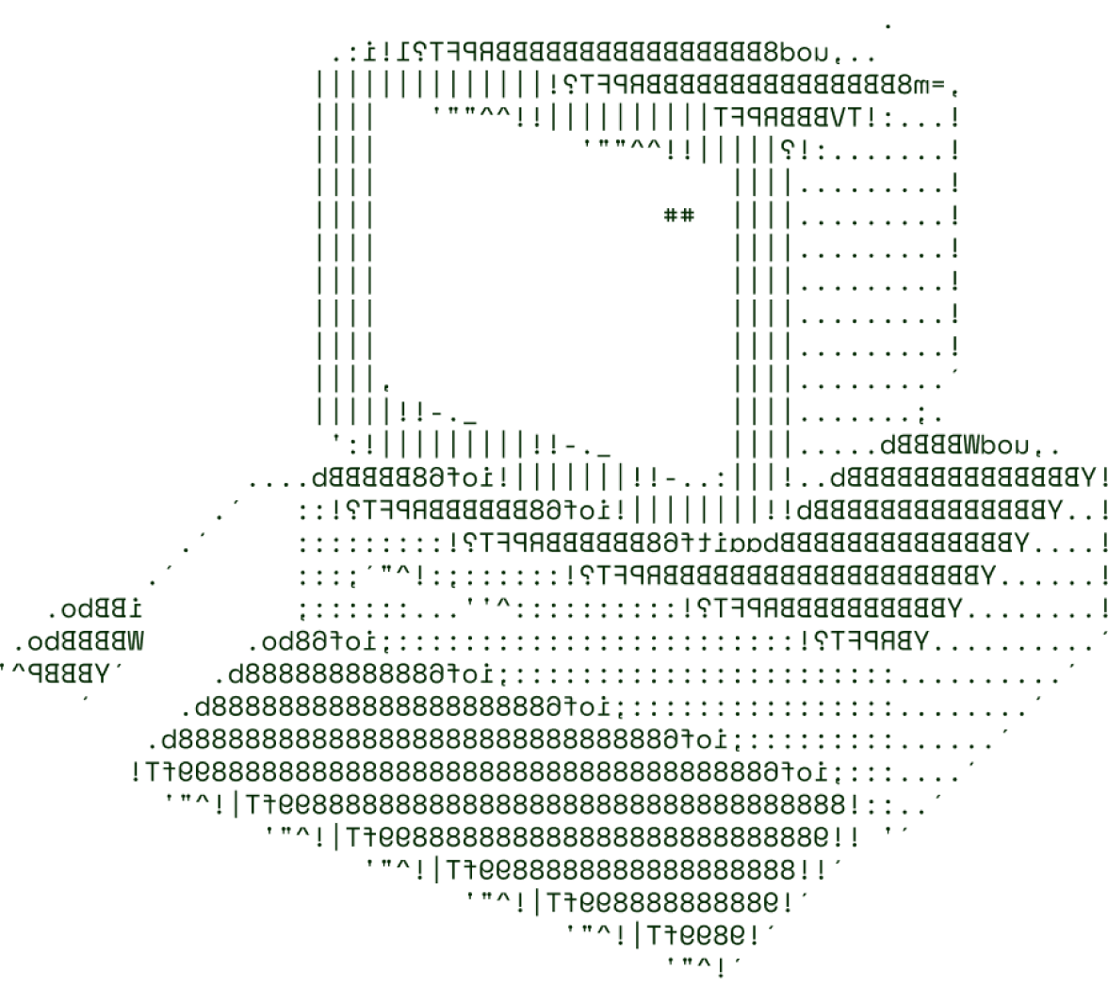

> Fission Aggregate
(Bootload Invaders)

Slide 2

SOLUTION OVERVIEW
Our solution provides small-scale manufacturers and producers to find mean sales values for their products and set their own so as to earn reasonably
The Problem is addressed by reducing the need to have to settle prices of the wares with third parties and rely on external malicious loan sharks.
The project is a great innovation in the field of telecommunication when the idea of communicating the worth of one’s effort is put on the table.
The Solution has many benefits for the impoverished in danger of having their hard work taken from them for pennies as well as for the general public that may avoid having to deal with the greed of exploitative salesmen.

Slide 3
TECHNICAL ARCHITECTURE
Tech stack
Frontend Technologies: HTML, CSS
Backend Technologies: Node.js, TypeScript
Database: MongoDB, SQL
Other Tools/Services: Git

Slide 4
SCALABILITY AND FUTURE SCOPE
Our solution has a very small load bearing capacity
Architecture considerations (MilesWeb/ Cloudflare Hosting)
Technologies that support scalability
Docker, Amazon Web Services
We aim to further update the product by integrating safe and secure transactions.

Slide 5
FEASIBILITY
Potential challenges and risks
The Project is at present incapable of supporting very large numbers of users and over time, performance may seem to degrade on lower specification devices.
Due to the small number of members within the team, the project has yet to experience real world use with diverse clientele.
Strategies for overcoming these challenges
Continuing forward with the project shall enable us to make the necessary optimizations so as to manage the needs of larger numbers of users.
We project that the size of our team may increase in the near future.

Slide 6

>Team Details

Slide 7





Aniruddh Dwivedi
Dhrubajoti Das
Member
None
Team leader
Company name

Slide 8

Thanks for Joining

